Slide 1

Department of Information Technology
NBA Accredited A.P. Shah Institute of Technology G.B.Road, Kasarvadavli, Thane(W), Mumbai-400615 UNIVERSITY OF MUMBAI Academic Year 2020-2021

Slide 2
A Project Report on
HomeDecor: AR Enabled Home Styler Application
Submitted in partial fulfillment of the degree of Bachelor of Engineering(Sem-8) in INFORMATION TECHNOLOGY By Tejas Khanted(17104015) Aniket Gaikwad(17104032) Kavan Naik(17104006) Under the Guidance of Prof. Kaushiki Upadhyaya and Prof. Nahid Shaikh

Slide 3
1.Project Conception and Initiation

Slide 4
1.1 Abstract
Augmented Reality (AR) in Furniture act as an interactive application that is based on Augmented Reality.
It explains all phases of building the Augmented Reality started with analyzing images from the rear camera of a smartphone or tablet using ground plane detection technique for displaying products detail and displaying 3D model and calculation of position to display a 3d model over real world image.
This Augmented Reality application can be used by the user to solve the problem of satisfy as they cannot put them into their own place before buying as it will help customers visualize how furniture pieces will look and fit in their homes and can also provide details of the product to support customer.

Slide 5
1.2 Objectives
To create a mobile based application for furniture placement using augmented reality technology.
To make user to visualize multiple furniture at they are own spaces.
To make User Friendly Interface design.
To produce correct information about selected objects dimensions and texture.
To produce realistic virtual furniture model in mobile app similar to the real furniture.

Slide 6
1.3 Literature Review
Sr. No. | Title | Author | Learning
1 | Augmented Reality and its effect on our life | Riya Aggarwal, Abhishek Singhal | From this paper, we have founded to use Superimposition Based Augmented Reality.
2 | Use of Augmented Reality in the furniture Industry | Elizabeth Simao Carvalho, Gustavo Macaes, Isabel Varajao, Nuno Sousa | In this paper, explains how furniture industry can used marker based AR and application in which connect via database for storing models, textures, color.
3 | Research on Object Based Augmented Reality Using Unity3din Education System | Dipti Rajan Dhotre | This paper explains how Augmented Reality and Unity 3d can work together in learning and training and how can it as potential impact in education.
4 | AR Development for Room Design | Peeranut Reuksupasompon, Maytichai Aruncharathorn, Sirion Vittayakorn | From this research paper, we founded to included feature to user that user will able to customize its own furniture by changing color.

Slide 7
1.4 Problem Definition
Problem Identified
As more and more purchases move online, new categories of products start gaining e-commerce traction. Using AR people can visualize the required furniture and make a perfect choice in between them so, making it easier rather than actually taking a note of dimensions, look and physically bringing of the furniture for making choice. The biggest problem with buying furniture is that you have almost no idea how it will actually look into your interior. This is why people hire visual designers who can show the whole picture.

Slide 8
1.5 Scope
Virtual furniture placement with a possibility to change item textures and translate.
The capability to take a photo of the placement.
Buy the furniture from the link provided.
AR allows user to try before buying it.

Slide 9
1.6 Technology stack
Unity 3D
Unity AR Foundation
AWS Cloud

Slide 10
1.7 Benefits for environment & Society
Augmented Reality Takes the Store to the Customer.
AR increases interaction and provides a richer user experience.
AR is mobile and personal and, therefore, hugely accessible to a rapidly growing smartphone market.
AR allows user to try before buying it and also allows user to customization the furniture.

Slide 11
2. Project Design

Slide 12
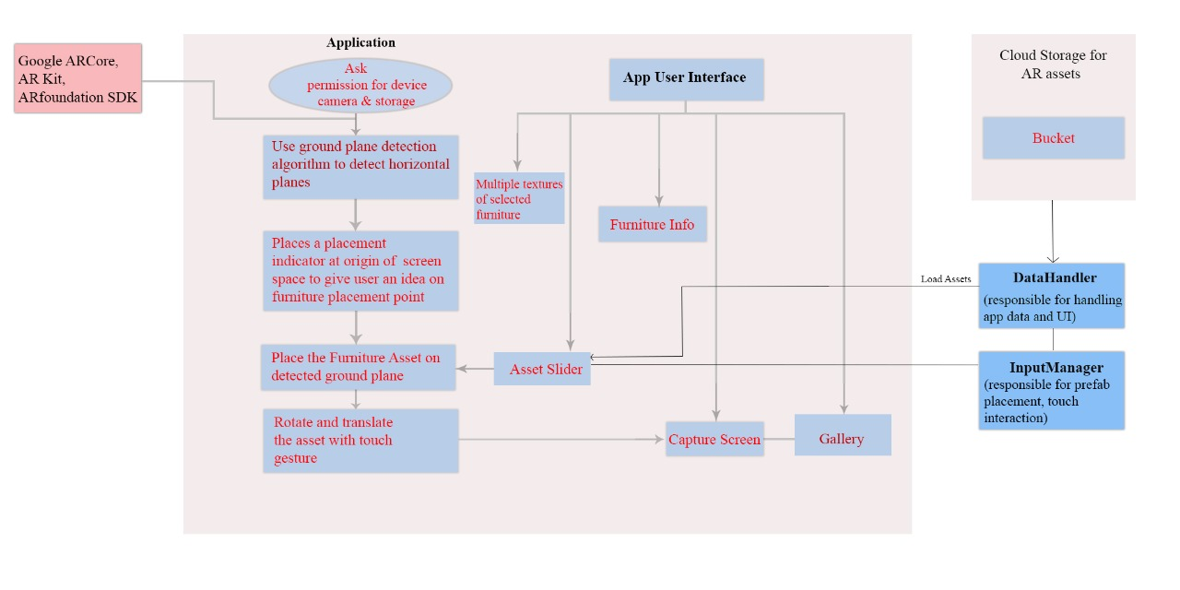
2.1 Proposed System

Slide 13
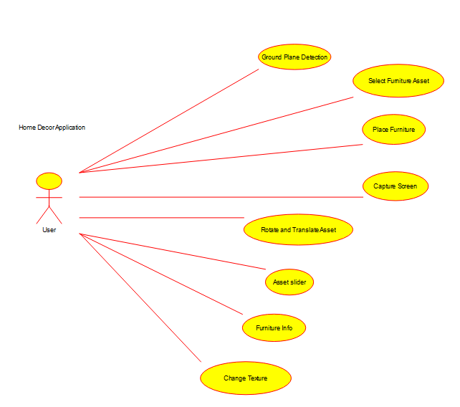
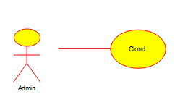
2.3 Use Case Diagram

Slide 14
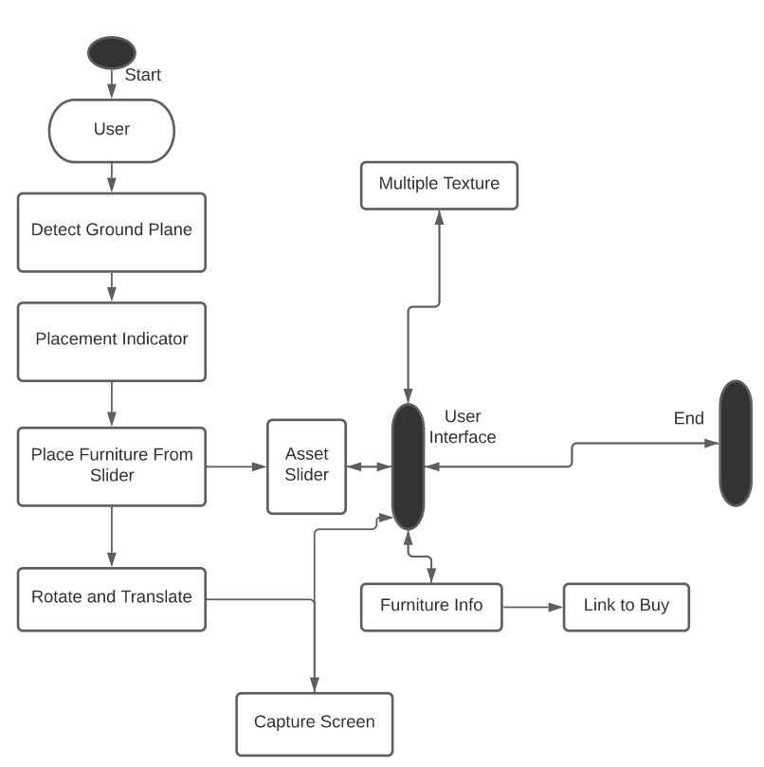
2.4 Activity diagram

Slide 15
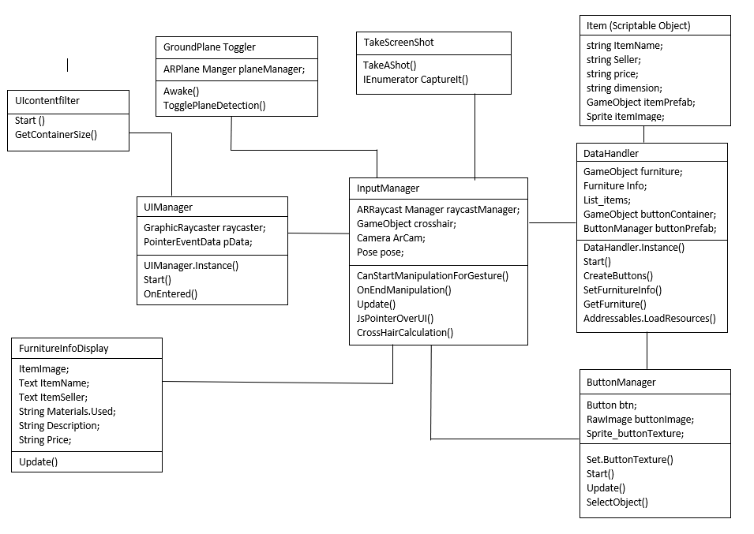
2.5 Class Diagram

Slide 16
3. Implementation

Slide 17
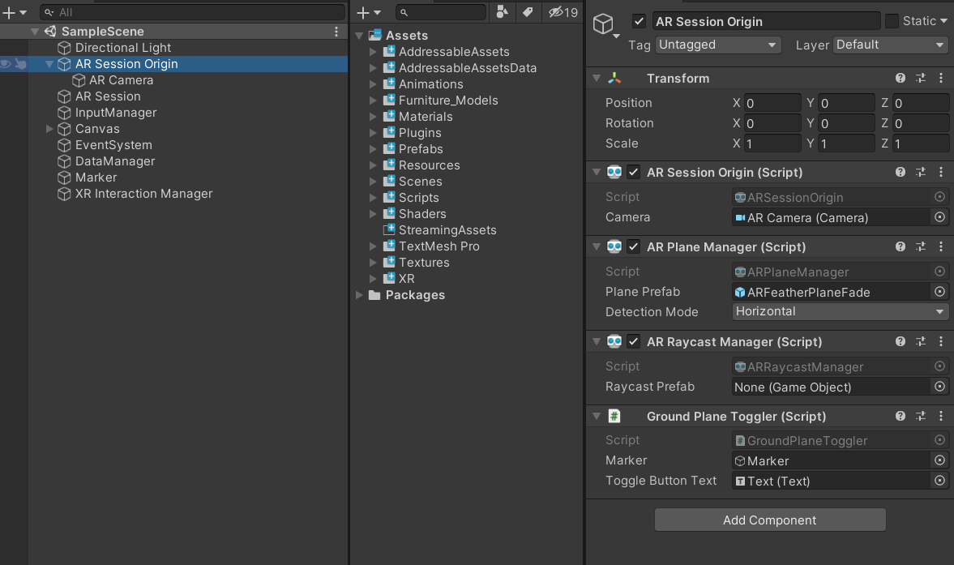
AR Session, AR camera and Plane Detection Mode: AR session is responsible to create a session for AR setup. It also has AR camera component. We can set the plane detection mode in AR Plane manager script as vertical, horizontal or both.

Slide 18
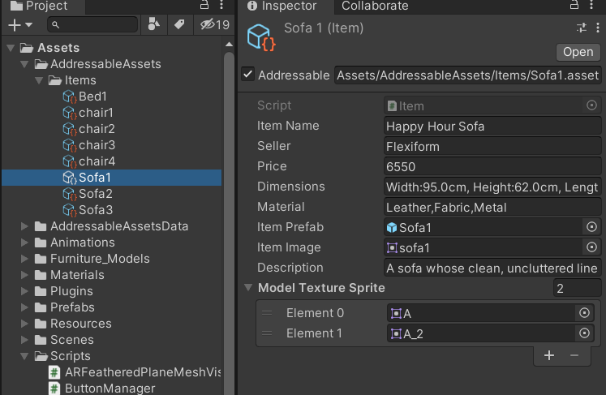
Store information about each furniture in a single container using scriptable object method.

Slide 19
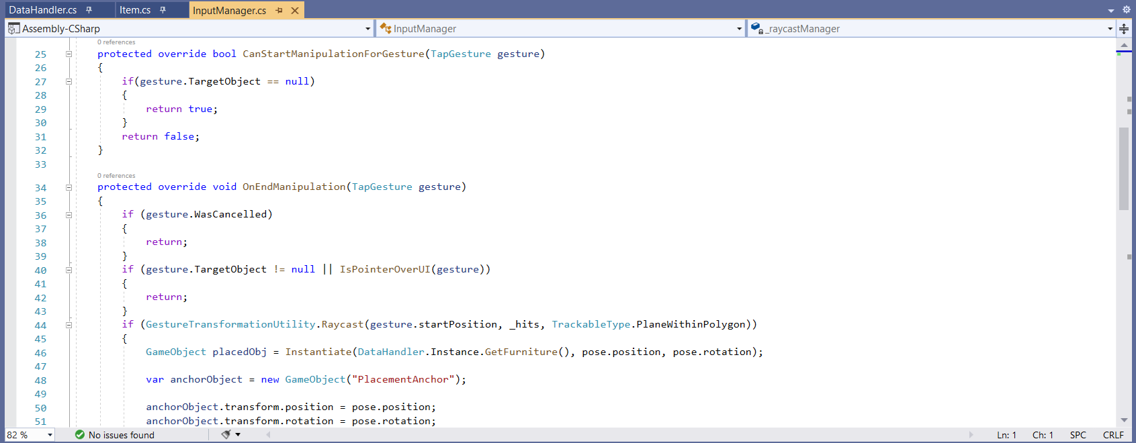
The Input Manager is responsible for placing the selected object on detected surface. Also Input Manager is responsible for touch gestures that is used to transform the furniture model.

Slide 20
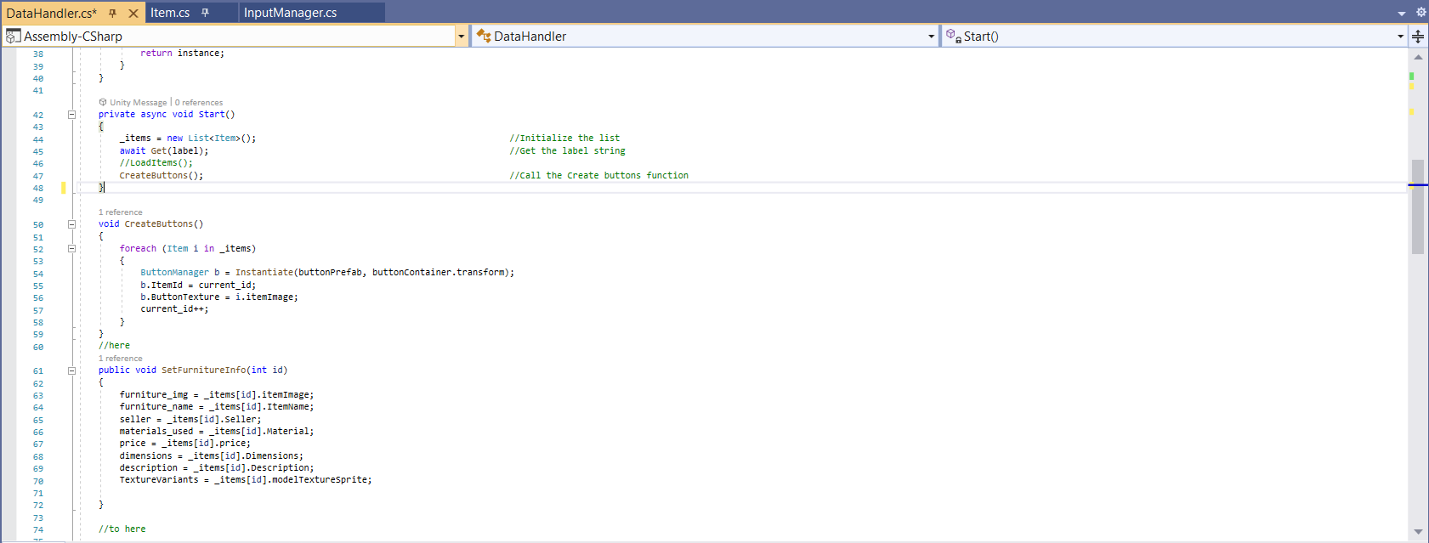
Data Handler is responsible for handling furniture data and app data.

Slide 21
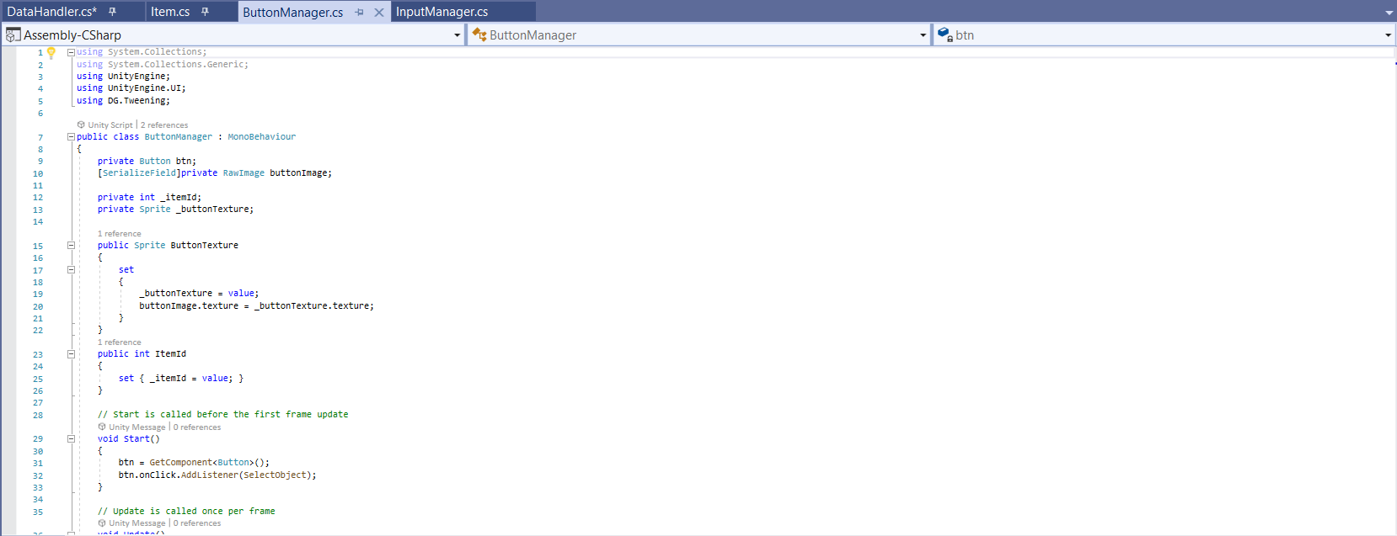
Button Manager is responsible for creating Button in Slider and mapping particular furniture prefab to the relevant button.

Slide 22
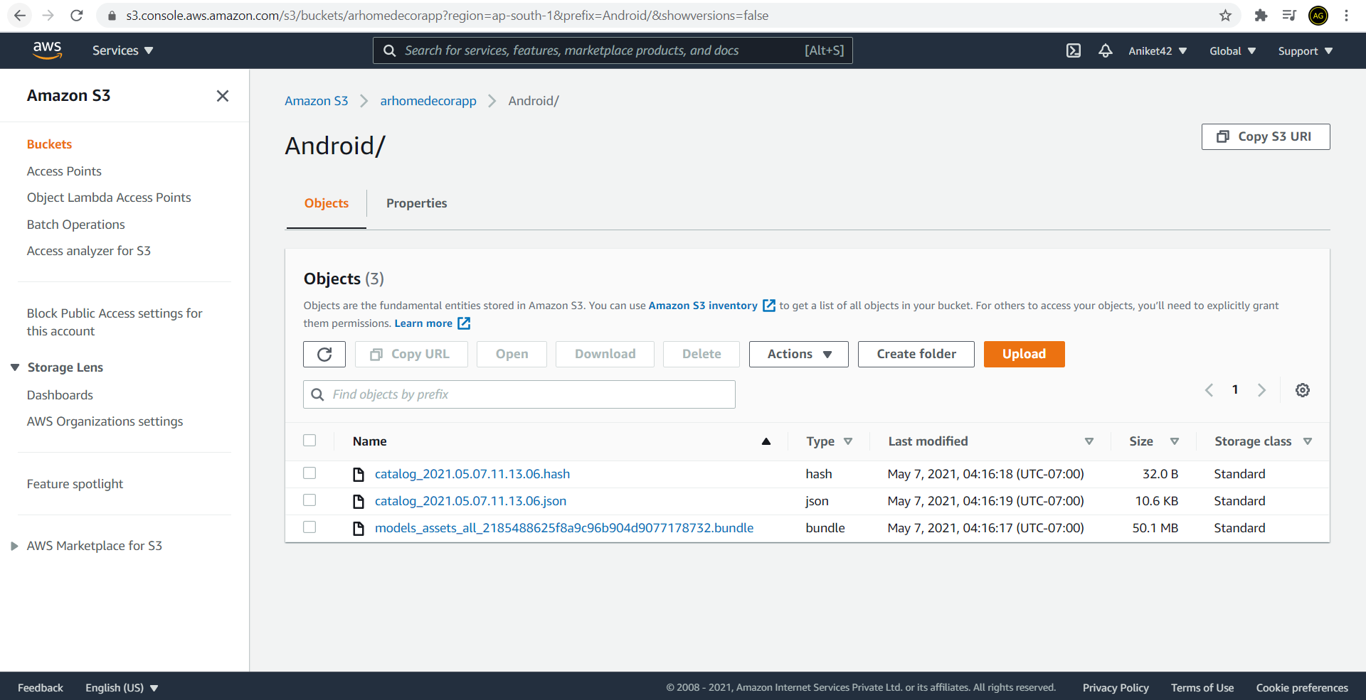
Assets stored on AWS cloud storage.

Slide 23
4. Testing

Slide 24
Test No. | Test Name | Expected Resulted | Actual Result
1 | Use Device Camera | Device Camera must be turned on while using the app. | Device’s camera turned on successfully.
2 | Ground Plane Detection | Ground Plane must be detected on Horizontal Surfaces | Ground Planes are successfully detected
Test Case 1: Basic App Functionalities.

Slide 25
Test No. | Test Name | Expected Resulted | Actual Result
1 | App Scalability | The assets used in app must be stored on cloud. | The assets are stored in S3 storage successfully.
2 | Load Assets | The assets must be loaded into application from cloud. | The assets are loaded into application from cloud successfully
3 | Asset Prefab Placement | The selected asset should be placed on detected ground plane on touch | The selected asset is placed on detected ground plane successfully
4 | Detect touch gestures | The application must be able to detect number of touch inputs | The app is able to detect touch inputs successfully
5 | Crosshair(Placement Indicator) | The app must place a crosshair on detected ground plane at origin of screen space | Crosshair is placed successfully.
Test Case 2: Main app functionalities.

Slide 26
Test No. | Test Name | Expected Resulted | Actual Result
1 | Asset Selection | Placed asset must be able to select. | Placed asset is selected successfully.
2 | Asset Rotation | Placed asset must be rotated on two finger gesture. | Placed asset is successfully rotated.
3 | Asset Translation | Placed asset must be able to translate to any position on the detected ground plane. | Asset is translated successfully
4 | Texture Change | Assets must be able to change texture if it has. | Textures is successfully changed.
5 | Remove Placed Asset | Placed asset must be removed . | Placed asset is removed successfully.
Test Case 3: Asset(Prefab/furniture model) functionalities.

Slide 27
Test No. | Test Name | Expected Resulted | Actual Result
1 | Load Buttons dynamically in slider relevant to asset. | Buttons be loaded into slider dynamically w.r.t assets. | Buttons are successfully loaded into slider dynamically w.r.t assets.
2 | Screenshot | App must be able to take screenshot of the scene. | ScreenShot is taken successfully.
3 | Ground Plane toggling | App must show/hide detected ground plane on button clicks. | Ground plane toggling is done successfully.
4 | Funiture information display | App must display a UI regarding the selected asset information , dynamically. | Asset information of selected asset is displayed on UI successfully.
5 | Redirect to buying page | Redirect user to the seller’s page on button click, where furniture could be purchased | Redirecting is done successfully.
Test Case 4: UI functionality

Slide 28
5. Result

Slide 29
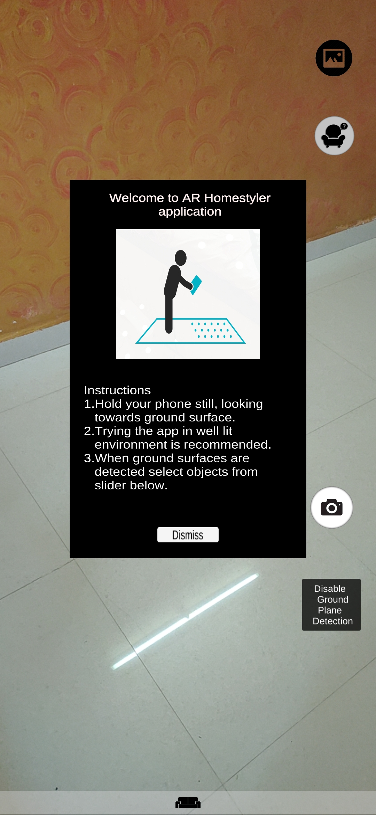
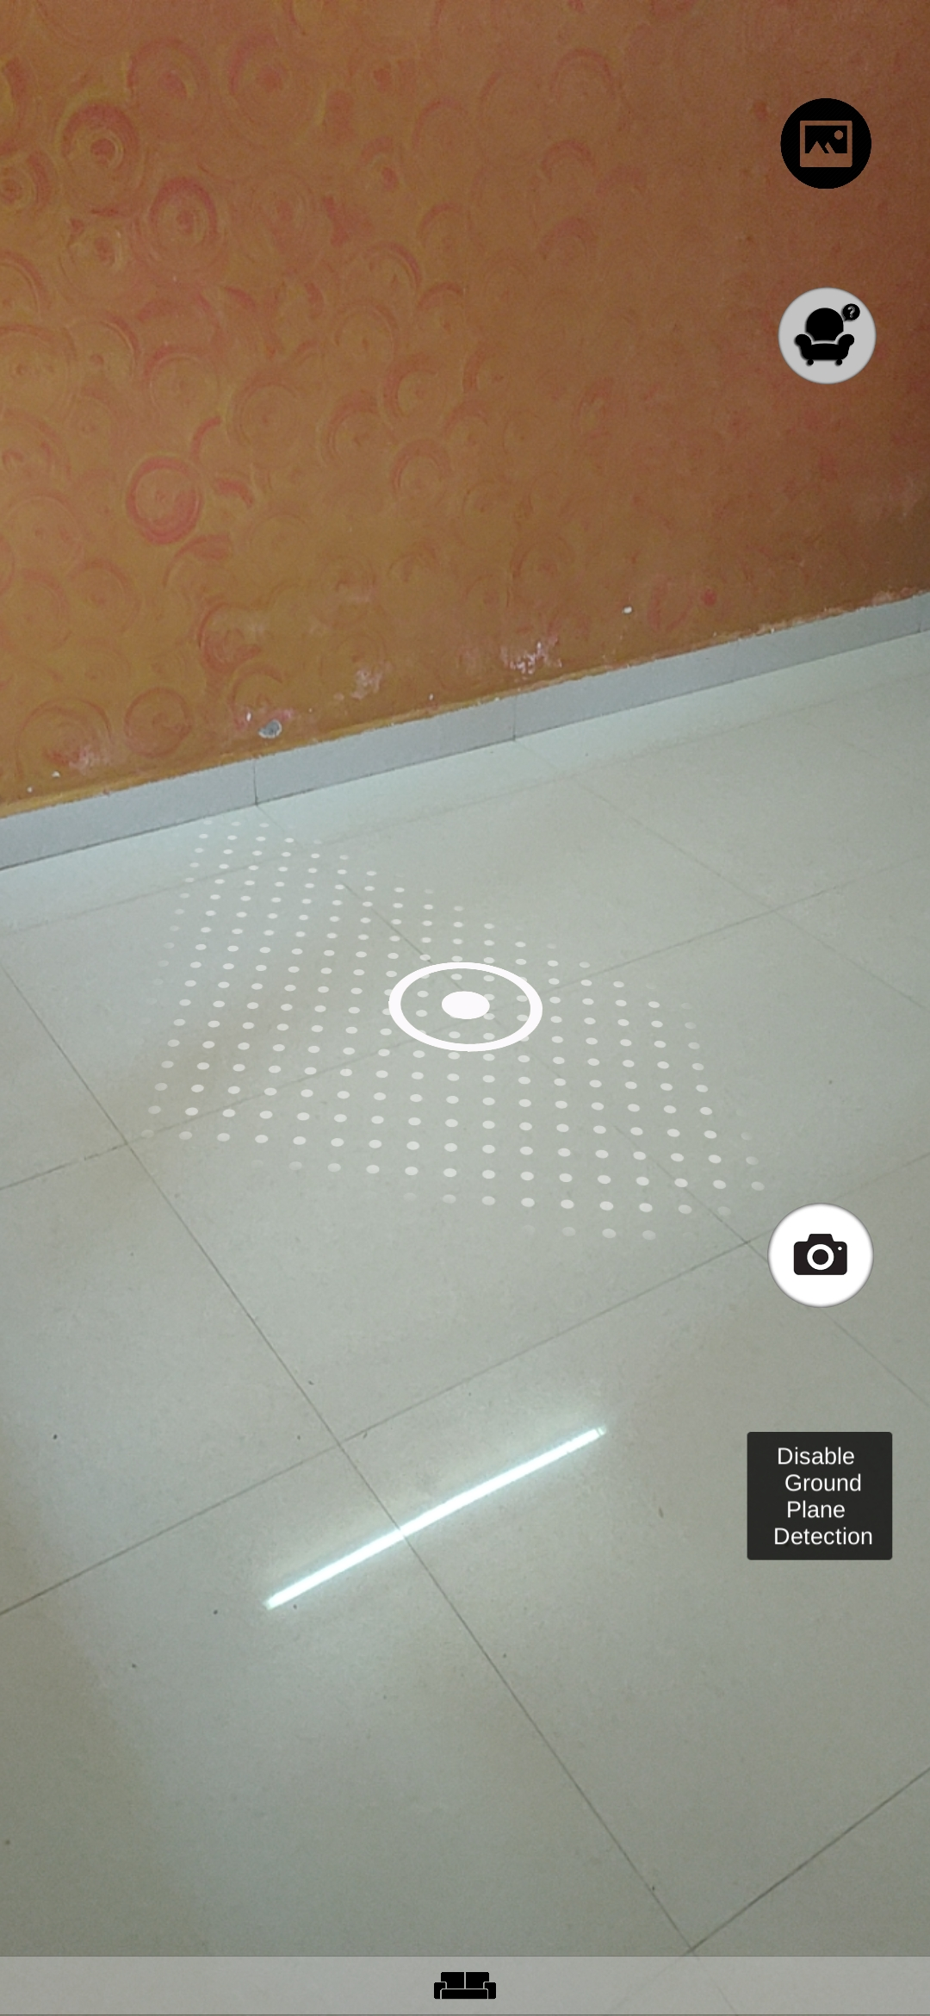
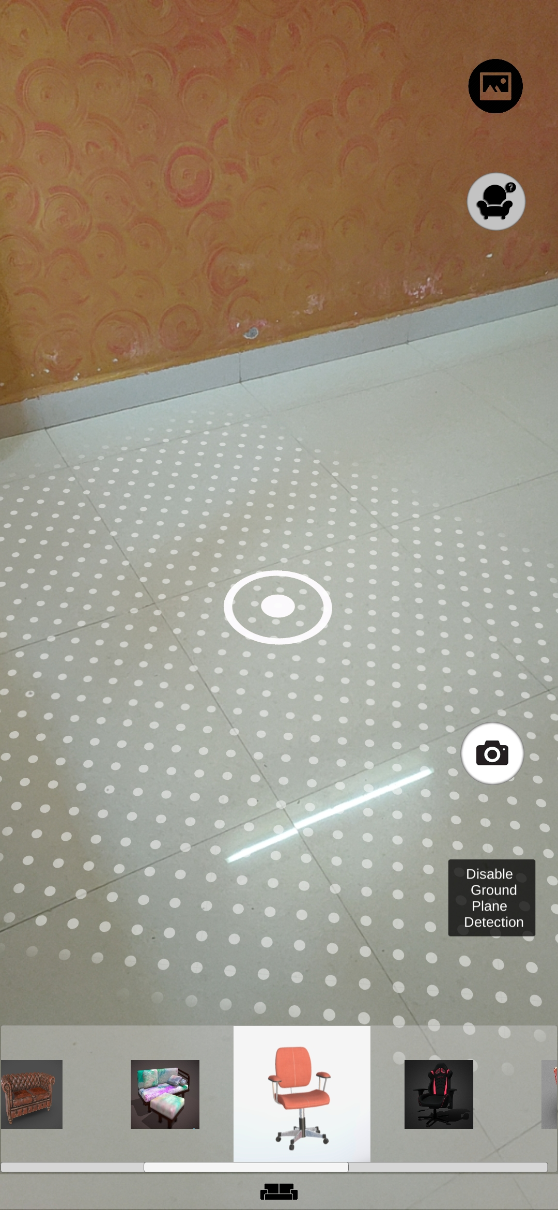
Welcome User Interface
Ground Plane Detection
Assets loaded into Slider

Slide 30
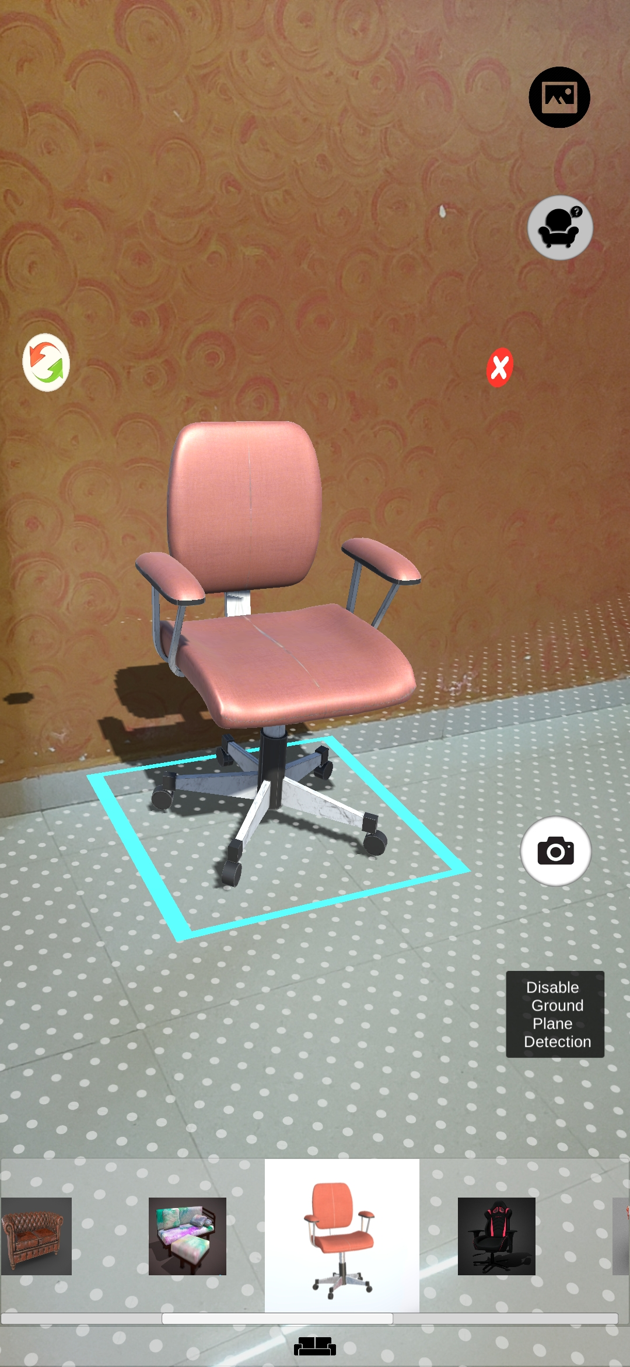
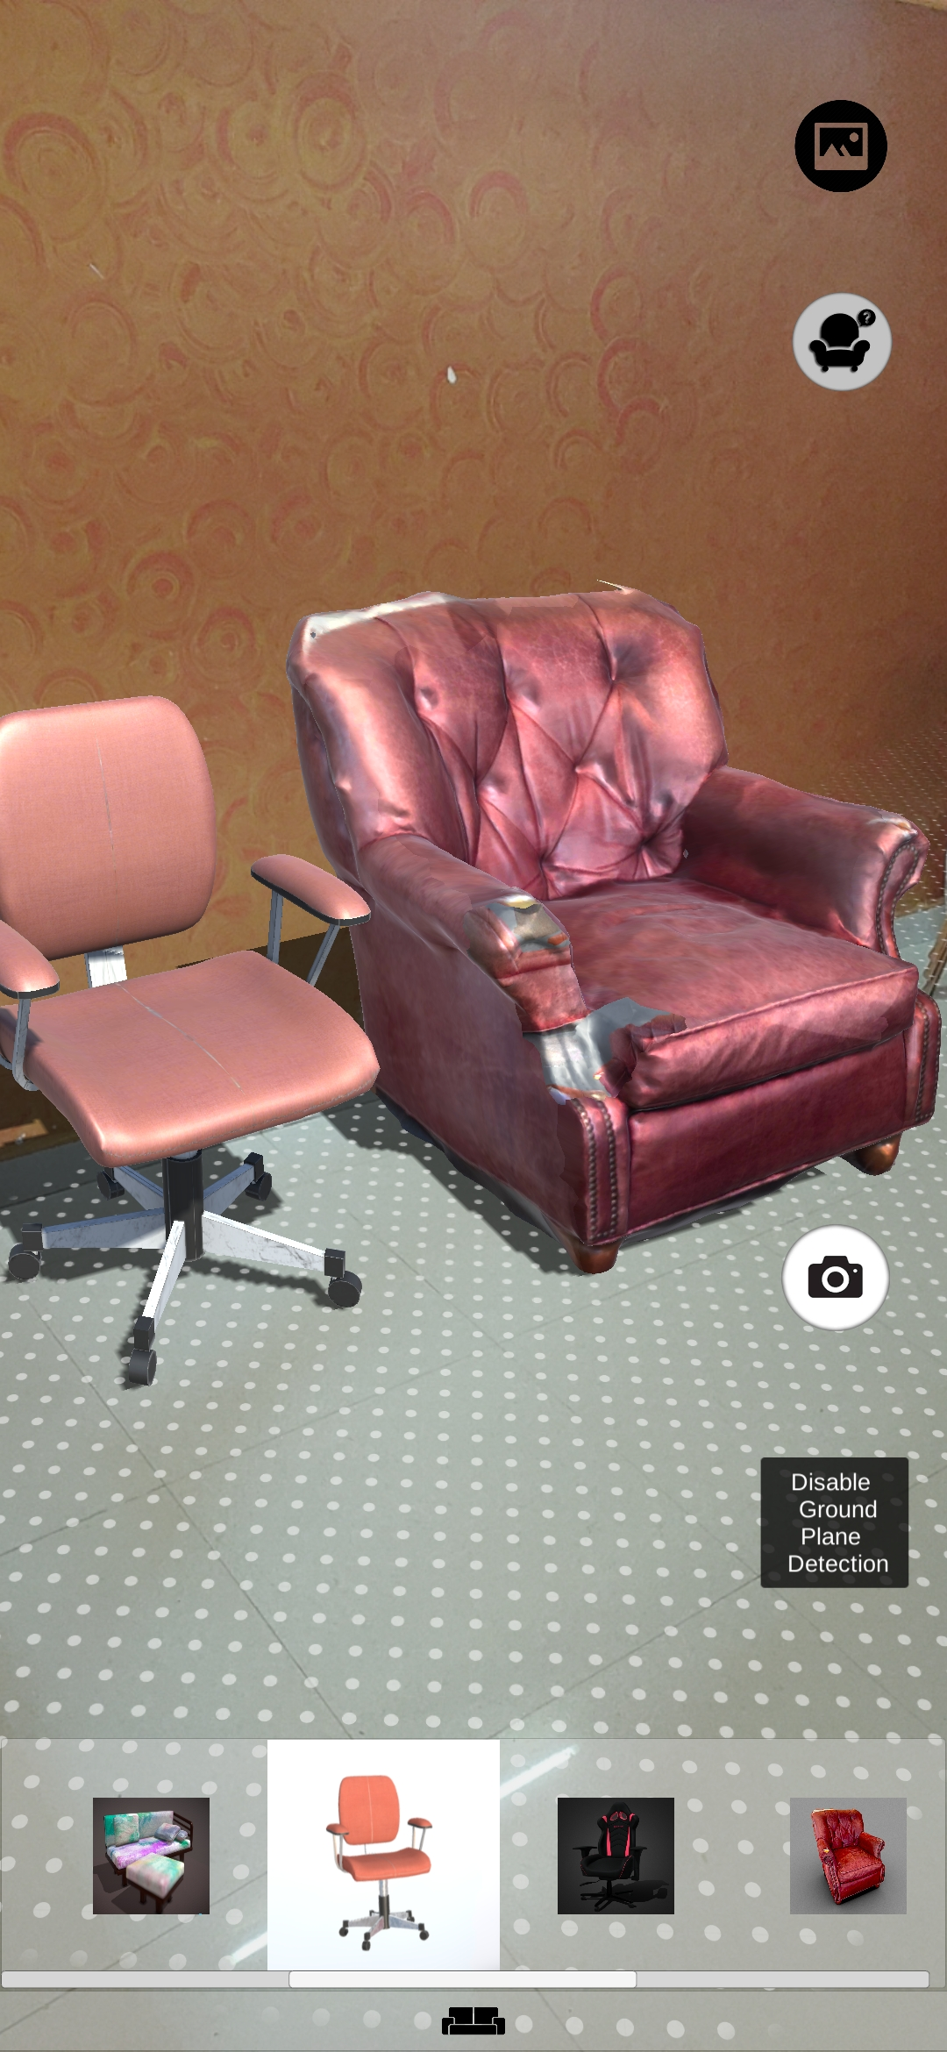
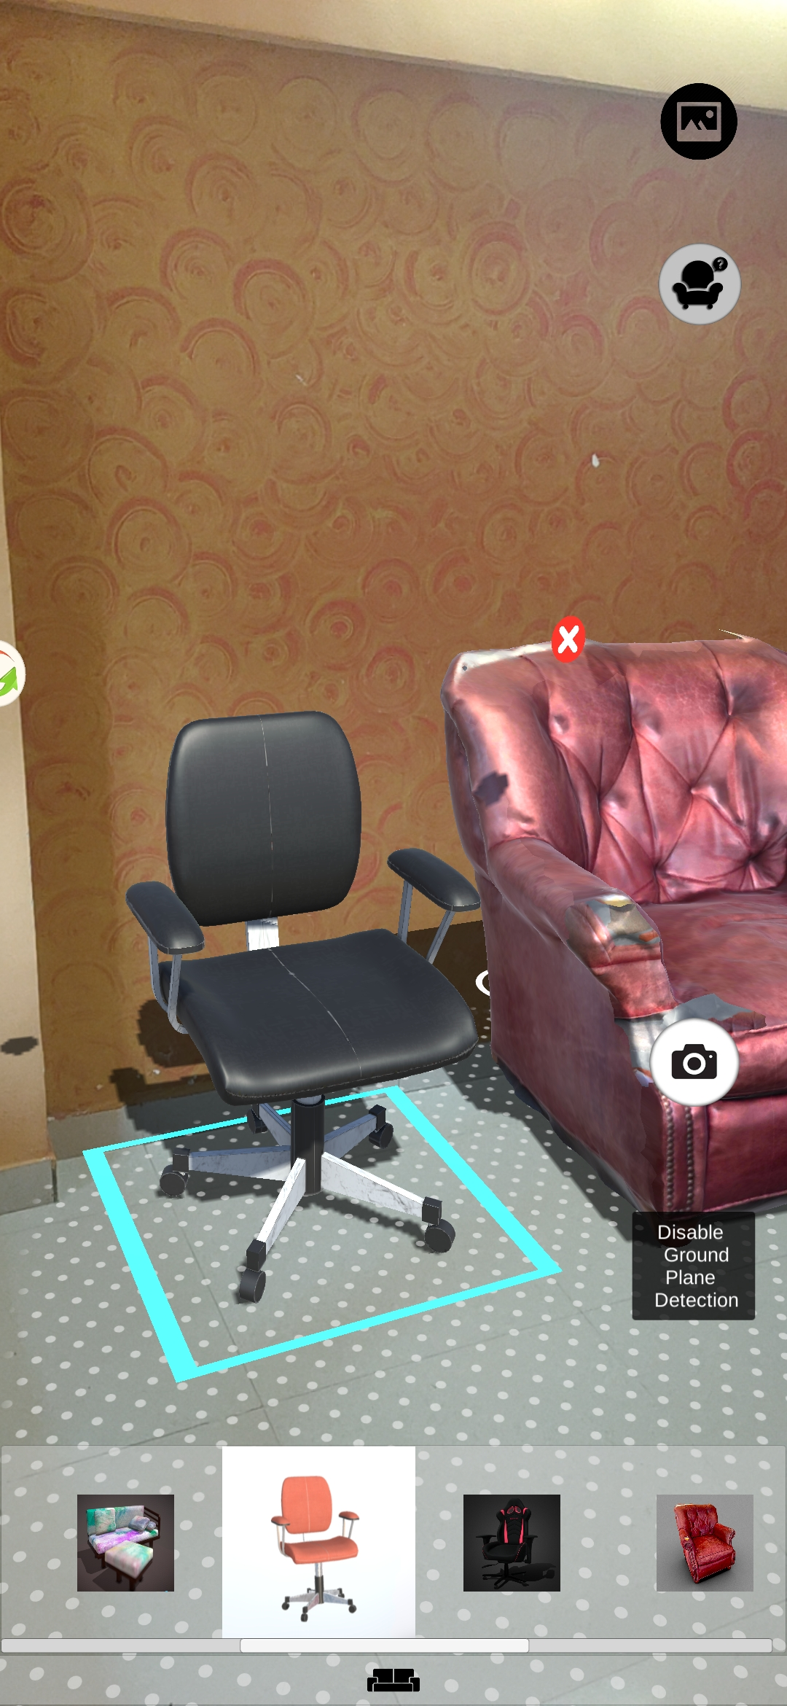
Single Object Placement
Multiple Object Placement
Change Textures Of Selected Object

Slide 31
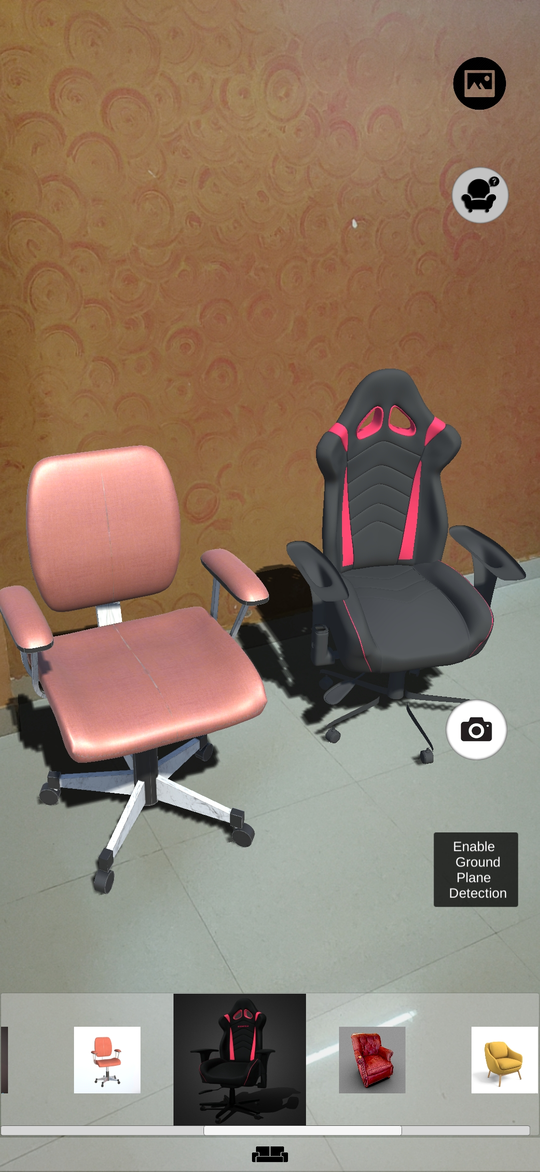
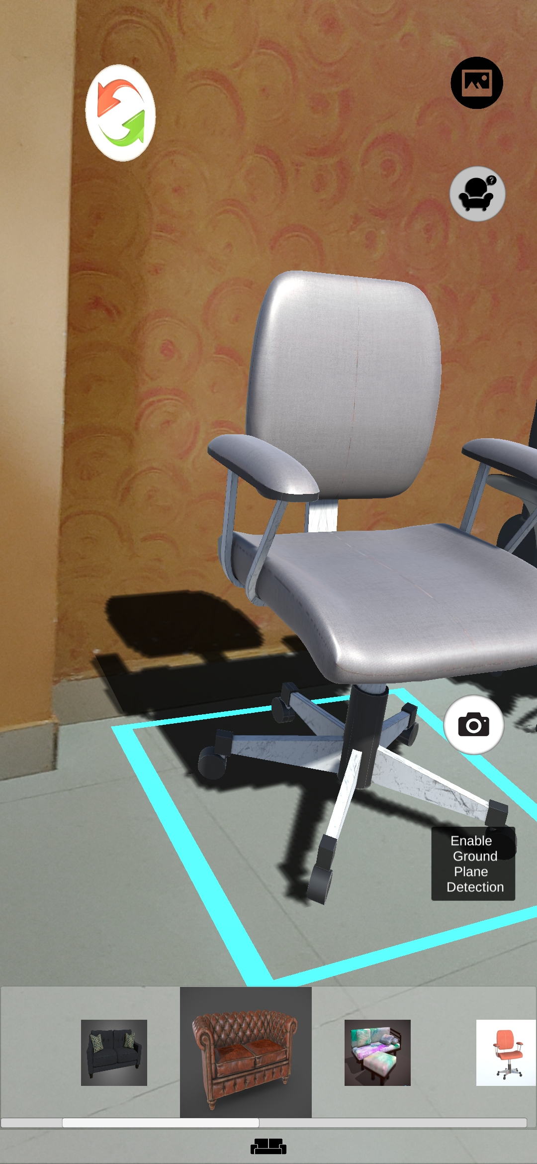
Disable Ground Plane Detection
Furniture Shadow

Slide 32
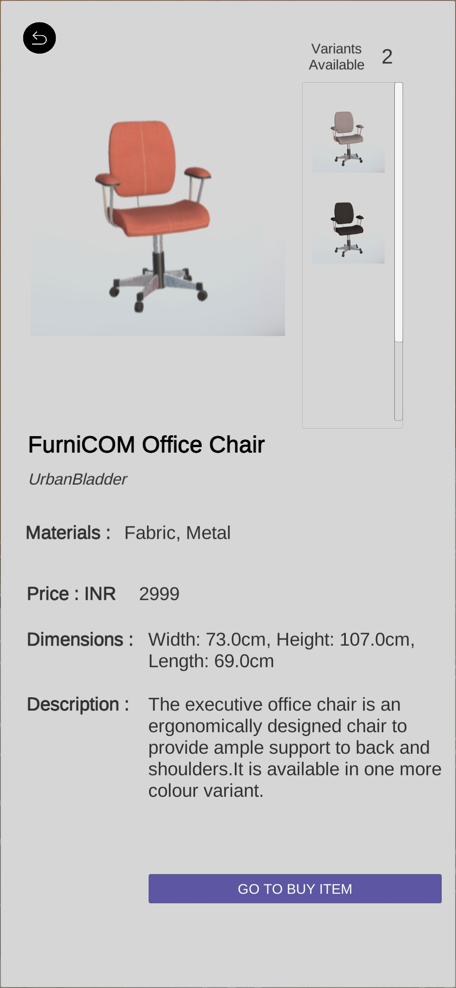
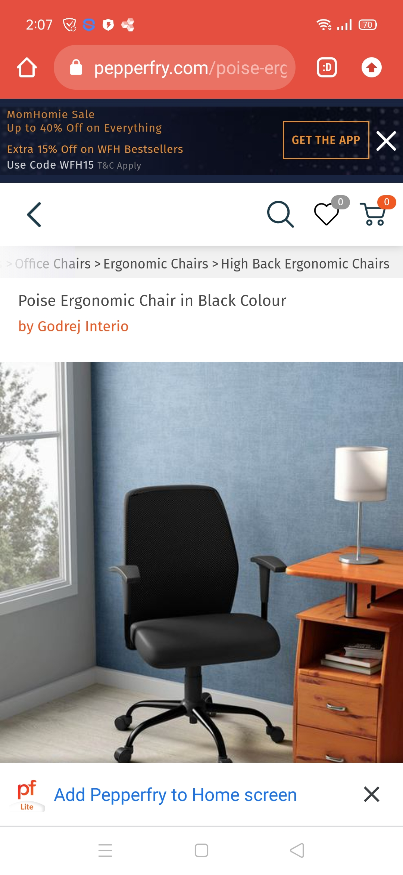
Furniture Information
Redirect to Website for Buying

Slide 33
6. Conclusion and Future Scope

Slide 34
In this AR environment, the user is able to adjust the properties of virtual furniture and create its own arrangements in the real world.
Through the mobile camera the user can detect the plan surface and select the furniture through the application and place it on the screen.
As a design solution, this application can help cut the prototyping costs and help simulate a better experience for the customer.
It also enables the User to be the designer themselves and make their home as they want it to be.
This application will also prove beneficial to the companies for boosting sales online.
Adding More Feature like Measuring Distance using AR will user ease to find the dimensions of furniture before order it.

Slide 35
References
R. Aggarwal and A. Singhal, ”Augmented Reality and its effect on our life,” 2019 9thInternational Conference on Cloud Computing, Data Science Engineering (Confluence),2019
P. Reuksupasompon, M. Aruncharathorn and S. Vittayakorn, ”AR Development For Room Design,” 2018 15th International Joint Conference on Computer Science and Soft-ware Engineering (JCSSE), 2018
Dhotre, Dipti Rajan. “Research on Object Based Augmented Reality Using Unity3d in Education System.” (2016).
Carvalho, Elizabeth Ma ̧c ̃aes, Gustavo Varaj ̃ao, Isabel Sousa, Nuno Brito, Paulo.(2011). Use of Augmented Reality in the furniture industry.
Unity 3D Documentation. URL: https://docs.unity3d.com/Manual/index.html
Unity 3D Forum. URL: https://forum.unity.com/
Google ARCore. URL: https://developers.google.com/ar/

Slide 36
Thank You

